Slide 1
CSUSM
Hypothesis Testing

Slide 2
Module Goals
After completing this Module, you should be able to:
Formulate null and alternative hypotheses for applications involving a single population mean or proportion
Formulate a decision rule for testing a hypothesis
Know how to use the test statistic and critical value to test the null hypothesis
Know what Type I and Type II errors are
Compute the probability of a Type II error

Slide 3
What is a Hypothesis?
A hypothesis is a claim (assumption) about a population parameter:
Claim: The mean monthly cell phone bill of this city is μ = $42

Slide 4
The Null Hypothesis, H₀
  The average number of TV sets in U.S. Homes is at least three :

Slide 5
The Null Hypothesis, H₀
(continued)
Begin with the assumption that the null hypothesis is true
  Similar to the notion of innocent until
  proven guilty
Refers to the status quo
Always contains “=” , “≤” or “≥” sign
May or may not be rejected for based on the evidence collected during testing.

Slide 6
The Alternative Hypothesis, H_{a}
Is the opposite of the null hypothesis
  e.g.: The average number of TV sets in U.S. homes is less than 3 ( H_{a}: μ < 3 )
Challenges the status quo Ho
Never contains the “=” , “≤” or “≥” sign
May or may not be accepted

Slide 7
Level of Significance, α
Defines unlikely values of sample statistic if null hypothesis is true
  Defines rejection region of the sampling distribution
Is designated by α , (level of significance or allowed error)
  Typical values are .01, .05, or .10
Is selected by the researcher at the beginning
Provides the critical value(s) of the test

Slide 8
Level of Significance and the Rejection Region
Level of significance =
α
Represents
critical value
H₀: μ ≥ 3 H_{a}: μ < 3
α
Rejection region is shaded
Lower tail test
0
H₀: μ ≤ 3 H_{a}: μ > 3
α
Upper tail test
0
H₀: μ = 3 H_{a}: μ ≠ 3
α
α
/2
/2
Two tailed test
0

Slide 9
Errors in Making Decisions
Type I Error
  Reject a true null hypothesis
  Considered a serious type of error
  The probability of Type I Error is α
    Called level of significance of the test
    Set by researcher in advance

Slide 10
Errors in Making Decisions
(continued)
Type II Error
  Fail to reject a false null hypothesis
  The probability of Type II Error is β
  Considered to be less impactful than the Type I error

Slide 11
Outcomes and Probabilities
Possible Hypothesis Test Outcomes
State of Nature
Decision
H₀ True
H₀ False
Do Not
No error
(1 - )
Type II Error
( β )
Reject
Key:
Outcome
(Probability)
α
H
0
Reject
Type I Error
( )
No Error
( 1 - β )
H
α
0

Slide 12
Critical Value
Approach to Testing
Convert sample statistic (e.g.: ) to test statistic ( Z or t statistic )
Determine the critical value(s) for a specified
level of significance α
If the test statistic falls in the rejection region, reject H₀ ; otherwise do not reject H₀

Slide 13
Lower Tail Tests
H₀: μ ≥ 3
H_{a}: μ < 3
The cutoff value,
or , is called a critical value
-z_{α}
x_{α}
α
Reject H₀
Do not reject H₀
-z_{α}
0
x_{α}
μ

Slide 14
Upper Tail Tests
H₀: μ ≤ 3
H_{A}: μ > 3
The cutoff value,
or , is called a critical value
z_{α}
x_{α}
α
Do not reject H₀
Reject H₀
0
z_{α}
μ
x_{α}

Slide 15
Two Tailed Tests
There are two cutoff values (critical values):
or
H₀: μ = 3 H_{A}: μ ≠ 3
± z_{α/2}
α/2
α/2
x_{α/2}
Lower
Upper
x_{α/2}
Reject H₀
Do not reject H₀
Reject H₀
-z_{α/2}
0
z_{α/2}
x_{α/2}
μ₀
x_{α/2}
Lower
Upper

Slide 16
Critical Value
Approach to Testing
Hypothesis
Tests for μ
σ Known
σ Unknown

Slide 17
Calculating the Test Statistic
Hypothesis
Tests for μ
σ Known
The test statistic is:

Slide 18
Calculating the Test Statistic
(continued)
Hypothesis
Tests for μ
σ Unknown
The test statistic is:
But is sometimes approximated using a z:
Large Sample

Slide 19
Calculating the Test Statistic
(continued)
Hypothesis
Tests for μ
σ Unknown
The test statistic is:
Small
Samples

Slide 20
Review: Steps in Hypothesis Testing
1. Specify the population value of interest
2. Formulate the appropriate null and alternative hypotheses
3. Specify the desired level of significance
4. Determine the rejection region
5. Obtain sample evidence and compute the test statistic
6. Reach a decision
7. Interpret the result

Slide 21
Hypothesis Testing Example
Test the claim that the true mean # of TV sets in US homes is at least 3.
(Assume σ = 0.8)
1. Specify the population value of interest
  The mean number of TVs in US homes
2. Formulate the appropriate null and alternative hypotheses
  H₀: μ ≥ 3 H_{a}: μ < 3 (This is a lower tail test)
3. Specify the desired level of significance
  Suppose that α = .05 is chosen for this test

Slide 22
Hypothesis Testing Example
(continued)
4. Determine the rejection region
= NORMSINV(0.05) = -1.645
α = .05
Reject H₀
Do not reject H₀
-z_{α}= -1.645
0
This is a one-tailed test with α = .05.
Since σ is known, the cutoff value is a z value:
Reject H₀ if z < z_{α} = -1.645 ; otherwise do not reject H₀

Slide 23
Hypothesis Testing Example
5. Obtain sample evidence and compute the test statistic
Suppose a sample is taken with the following results: n = 100, x = 2.84 (σ = 0.8 is assumed known)
  Then the test statistic is:
Ho: µ ≥ 3

Slide 24
Hypothesis Testing Example
(continued)
6. Reach a decision
α = .05
z
Reject H₀
Do not reject H₀
-1.645
0
-2.0
Since z (test) = -2.0 < -1.645, we reject the Ho
7. The mean number of TVs in US homes is not ≥ 3

Slide 25
Example: Upper Tail z Test for Mean (σ Known)
A phone industry manager thinks that customer monthly cell phone bill have increased, and now average over $52 per month. The company wishes to test this claim. (Assume σ = 10 is known)
Form hypothesis test:
H₀: μ ≤ 52 the average is not over $52 per month
H_{a}: μ > 52 the average is greater than $52 per month
(i.e., sufficient evidence exists to support the
manager’s claim)

Slide 26
Example: Find Rejection Region
(continued)
Suppose that α = .10 is chosen for this test
Find the rejection region:
Reject H₀
= NORMSINV(0.9) = 1.28
α = .10
Do not reject H₀
Reject H₀
0
z_{α}=1.28
Reject H₀ if z test) > 1.28

Slide 27
Example: Test Statistic
(continued)
Obtain sample evidence and compute the test statistic
Suppose a sample of 64 is taken with the following results: Then, the test statistic is:

Slide 28
Example: Decision
(continued)
Reach a decision and interpret the result:
Reject H₀
α = .10
Do not reject H₀
1.28
Reject H₀
0
z = .88
Do not reject H₀ since z(test) = 0.88 ≤ 1.28
i.e.: there is not sufficient evidence that the
mean bill is over $52

Slide 29
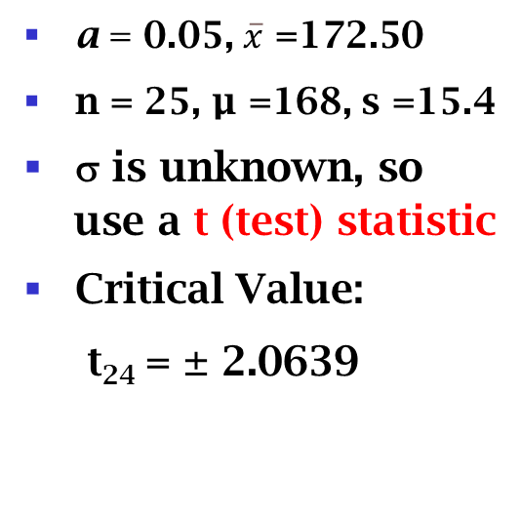
Example Solution: Two-Tail Test
=TINV2T(0.05,24)=2.0639
Small Sample
H₀: μ = 168 H_{a}: μ ≠ 168
α/2=.025
α/2=.025
a = 0.05, $\overline{x}$ =172.50
n = 25, µ =168, s =15.4
σ is unknown, so
use a t (test) statistic
Critical Value:
t₂₄ = ± 2.0639
Reject H₀
Do not reject H₀
t_{α/2}
Reject H₀
-t_{α/2}
0
-2.0639
2.0639
1.46
Do not reject H₀: not sufficient evidence that true mean is different than168

Slide 30
Regents Park Publishers
Hypothesis Testing
End

