Slide 1
Chapter 1 - Business Now: Change Is the Only Constant

Slide 2
Learning Outcomes
Define business and discuss the role of business in the economy
Explain the evolution of modern business
Discuss the role of nonprofit organizations in the economy
Outline the core factors of production and how they affect the economy
Describe today’s business environment and discuss each key dimension
Explain how current business trends might affect your career choices

Slide 3
Business Basics: Key Definitions
LO 1
Business: Any organization or activity that provides goods and services to earn a profit
Profit: Money that a business earns in sales, (or revenue), minus expenses
Loss: Occurs when a business incurs expenses that are greater than its revenue
Entrepreneurs: People who risk their time, money, and other resources to start and manage a business

Slide 4
Business
LO 1
Improves the standard of living of people and contributes to higher quality of life
Provides the products and services that people need and jobs
Contributes to society through innovation

Slide 5
History of Business
LO 2
Industrial Revolution
From the mid-1700s to the mid-1800s, technological advances fueled rapid industrialization in America
Entrepreneurship era
In the second half of the 1800s, large-scale entrepreneurs emerged and built business empires

Slide 6
History of Business (continued)
LO 2
Production era
In the early 1900s, businesses refined production process and created greater efficiencies
Marketing era
After WWII, businesses began to develop brands to help consumers understand the differences among different products
Relationship era
Today, firms aim to build long-term relationships with customers

Slide 7
Nonprofits and the Economy
LO 3
Nonprofits: Business-like establishments that employ people and produce goods and services
Goal - To contribute to the community
Do not generate financial gain

Slide 8
Factors of Production
LO 4
Elements that businesses need to achieve their objectives
Natural resources
Inputs that offer value in their natural state
Capital
Synthetic resources that a business needs to produce goods or services

Slide 9
Factors of Production (continued)
LO 4
Human resources
Physical, intellectual, and creative contributions of everyone who works within an economy
Entrepreneurship
Creating opportunities by harnessing other factors of production

Slide 10
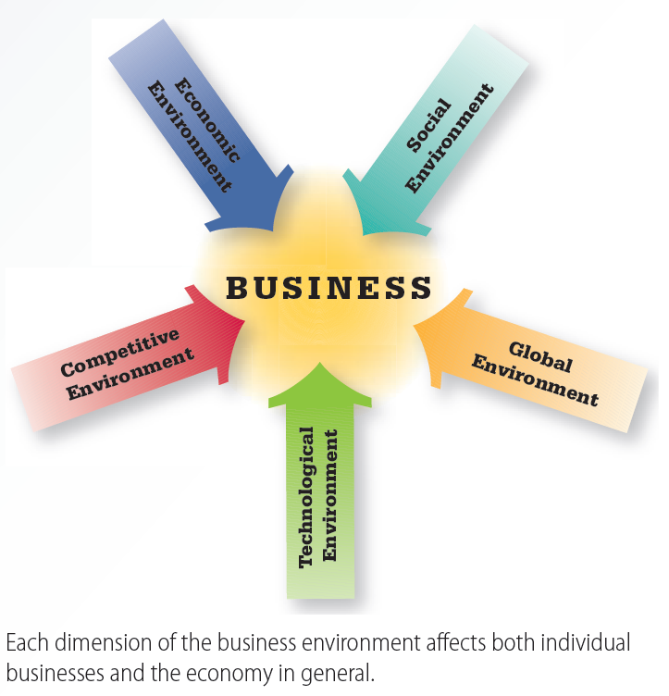
1.1 The Business Environment
LO 5

Slide 11
Economic Environment
LO 5
Governments take active steps to reduce the risks of business, to stabilize the economy, and to induce growth
Affected by corruption and ethical lapses, such as shady accounting

Slide 12
Competitive Environment
LO 5
Companies develop long-term, mutually beneficial relationships with customers
Speed-to-market provides competitive advantage
Speed-to-market: Rate at which a new product moves from conception to commercialization

Slide 13
Workforce Advantage and Technological Environment
LO 5
Workforce advantage
Finding and holding the best talent contributes to a firm’s competitive edge
Technological environment - Impact of digital technology has transformed businesses
Business technology: Tools used by businesses to become efficient and effective, such as e-commerce

Slide 14
Social Environment
LO 5
Embodies the values, attitudes, customs, and beliefs shared by groups of people
Demographics: Measurable characteristics of a population
Social trends
Diversity
Aging population
Rising worker expectations
Ethics and social responsibility

Slide 15
Global Environment
LO 5
Technology and free trade have blurred lines between individual economies in the world
Migration of jobs relates closely to the global movement toward free trade

Slide 16
Global Environment (continued)
LO 5
General Agreement on Tariffs and Trade (GATT): International trade agreement that has taken bold steps to lower tariffs and promote free trade worldwide
War, terrorism, disease, and natural disasters have taken an economic toll globally

Slide 17
Business and Individual Career Choices
LO 6
Following one's passion boosts the chances of both financial and personal success
Financial success is influenced by the economy and by one’s business skills
The right career choice should be made on the basis of what one loves to do

Slide 18
Key Terms
Value
Business
Profit
Loss
Entrepreneurs
Standard of living
Quality of life
Nonprofits
Factors of production
Business environment
Speed-to-market
Business technology
World Wide Web
E-commerce
Demographics
Free trade
General Agreement on Tariffs and Trade (GATT)

Slide 19
Summary
Business improves people’s standard of living and increases the quality of life
Modern business has evolved through different eras from the Industrial Revolution to the relationship era today
Nonprofit organizations work along with businesses to improve the quality of life in society

Slide 20
Summary (continued)
Businesses rely on the factors of production to achieve their objectives
Business environment, which includes its five dimensions, can make a critical difference in whether an overall economy thrives or disintegrates
Career choices are affected by the broader economy and business skills

Slide 21
Chapter 1 - Business Now: Change Is the Only Constant

