Slide 1
Evaluating the Effectiveness of ICE-Drones for Enhanced Search & Rescue with the U.S. Coast Guard
ENM 607 Capstone
Evaluating the Effectiveness of ICE-Drones for Enhanced Search and Rescue with the U.S. Coast Guard
The Fantastic Five
Rocio Rivera, Gloria Rorie, Joanne Ro, Koffi Yegbe, Javier Delgado-Garcia
October 2023

Slide 2
Purpose
The purpose of this study is to fulfill the requirements for the Master of Science in Engineering Management at National University. The primary objective of this research is to assess the efficacy of implementing a gasoline-powered long-range drone within the United States Coast Guard (USCG) for the purpose of enhancing Search and Rescue (SAR) missions.
Armada Research and Development is a subsidiary of a Canadian pharmaceutical distribution company, currently operating in Canada, the Middle East, and the U.S. The company's primary objective is to evaluate the feasibility of commercializing a long-range, non-military delivery drone

Slide 3
The Fantastic Five
Rocio Rivera has a B.S. degree in Business Management with a focus in Human Resources from Regent University in Virginia Beach, VA. She is currently an Integration and Test IPT Project Manager at Northrop Grumman. She lives in Temecula, California.
Gloria Rorie has a B.S. degree in Electrical and Computer Engineering. She is currently employed as a System Architect at NAVWAR San Diego. She lives in San Diego, California.
Joanne Ro has a B.S. degree in International Business from California State University, Long Beach. She is currently employed as a Configuration Analyst at Northrop Grumman. She lives in Long Beach, California.
Koffi Yegbe has a B.S. degree in Construction Engineering Technology from National University. He is currently a U.S. Navy Sailor. He lives in Chesapeake, Virginia.
Javier Delgado-Garcia has a B.S. degree in Mechanical Engineering from Instituto Tecnologico Nacional de Mexico. He is currently employed by Pfizer in San Diego as the Lead of Energy and Sustainability team for Region 3 in North America as well as the SME on HVAC systems.

Slide 4
SMART+ Objective
Key Question: Could the integration of Armada's long-range, gas-powered drone into SAR operations contribute to a 10% enhancement in search effectiveness?
Current State
Assumes current benchmark of 100% in
Search Effectiveness
in the
US Coast Guard
Proposed Solution
Implementation of Armada’s long-range gas-powered drone in the search portion of SAR missions
Future State
+10% Increase
in Search Effectiveness
SMART+
✓ Specific: Improve the efficiency of search operations in the US Coast Guard SAR mission
✓ Measurable: Reduce average time required in search
✓ Achievable: by Implementing Armada’s drone
✓ Realistic: Crucial to fulfill mission of saving lives
✓ Time-bound: 2-year implementation
✓ Ethical: Inc in search effectiveness = more lives saved
Dependent Variable | Effectiveness of Search
Independent Variables | Endurance Swath Width Speed Readiness Time
Notes:
Rocio Rivera

Slide 5
The Scope of Work
In Scope
Analysis of the defined independent variables: Endurance, Swath, Speed, & Readiness Time
Simulation model showing search effectiveness of current state & implementing drones in the search portion of SAR missions
Out of Scope
Financial Analysis
Design of the drone
Environmental impacts
Resource Allocation
Maintenance and Reliability
Legal and Regulatory Considerations
Public Relations and Perceptions
Search and Rescue Operations Expertise
Final Deliverables
Final Report (PDF format)
PowerPoint Presentation
Notes:
Rocio Rivera

Slide 6
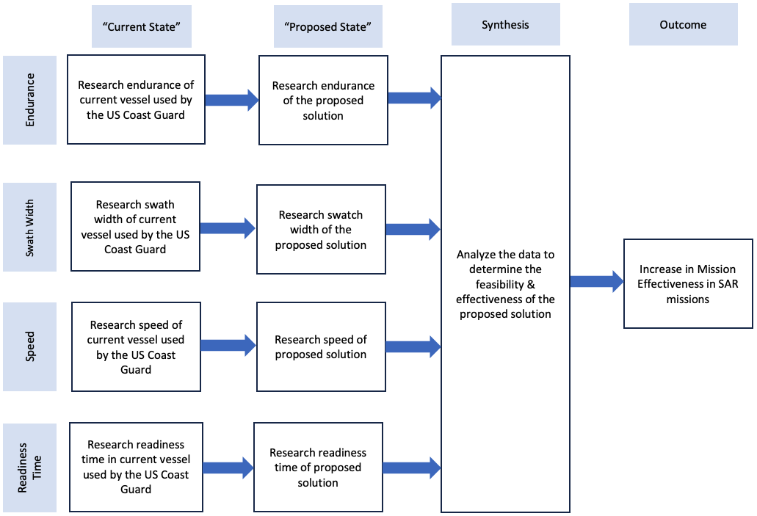
Project Methodology
Notes:
Rocio Rivera

Slide 7
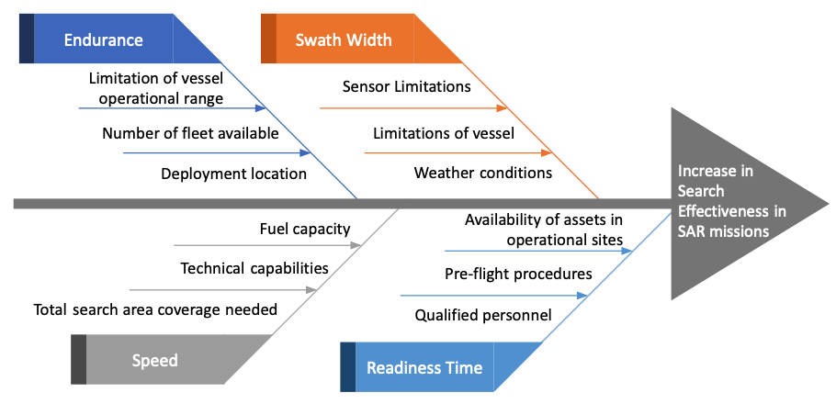
Fishbone Diagram
Notes:
Rocio Rivera

Slide 8
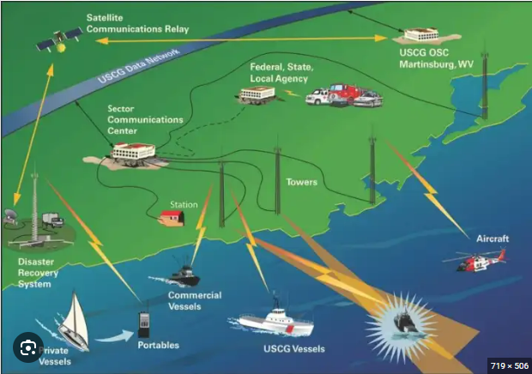
Search Operations Overview
[4]
Notes:
Javier Delgado-Garcia

Slide 9
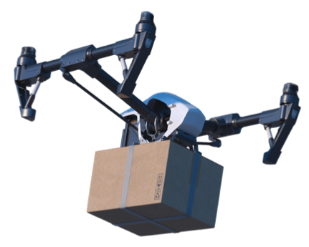
Armada Drone & USCG MH-65
The Armada ICE-powered Drone
Payload: 8 kg
Engine: 85cc two-stroke, single-cylinder, 18.6kW
Endurance: 11 hours
Fuel usage: 0.56 liters per hour at full load
Fuel type: Unleaded. Min 94 octanes
Maximum wind speed: 60 km/h
Maintainability: Fully modular, no specialties tools required.
Maximum velocity: 110 km/h
Maximum altitude: 400 ft limited only by aircraft regulations
The U.S. Coast Guard MH-65
Length (with rotor blades): 44 feet 5 inches
Rotor Diameter: 39 feet 2 inches
Height: 13 feet 3 inches
Maximum Weight: 9,480 pounds
Cruise Speed: 148 knots
Range: 350 nautical miles
Endurance: three hours
[1]
Notes:
Javier Delgado-Garcia

Slide 10
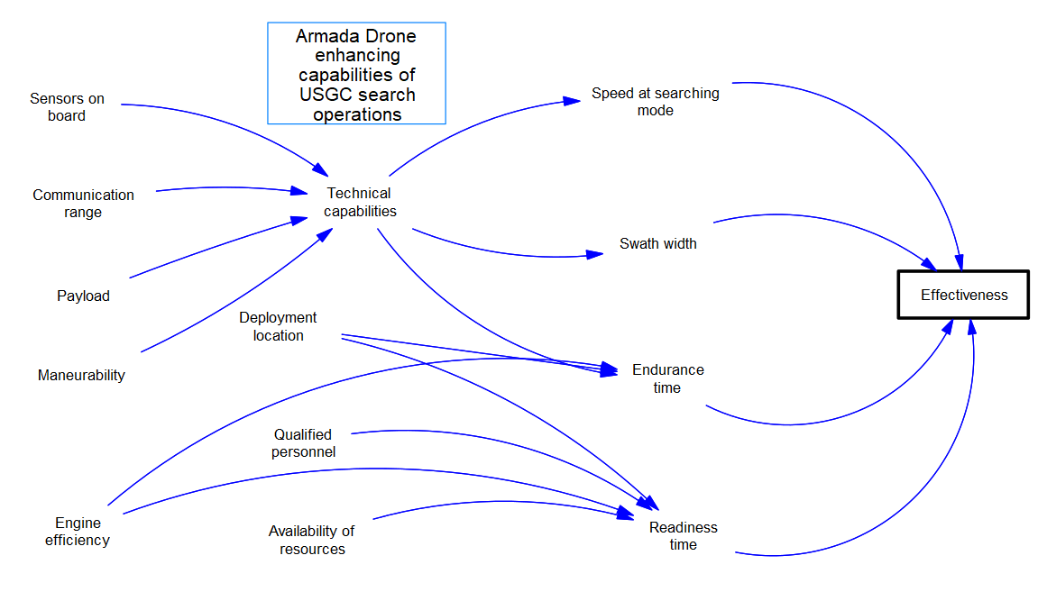
Causal Diagram
Armada Drone enhancing capabilities of USCG search operations
Notes:
Javier Delgado-Garcia

Slide 11
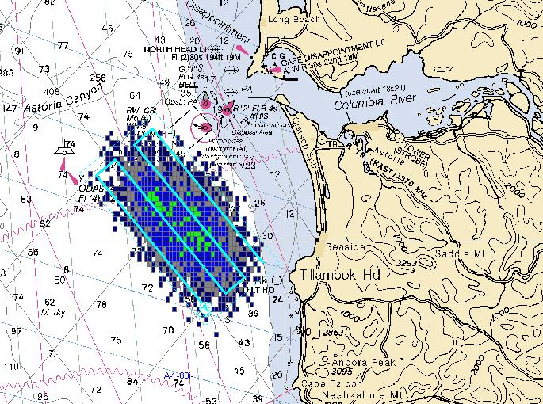
Mathematical Equations
Equation 1
Area covered in the assigned time = (Endurance-Time to setup the aircraft)*(Velocity at searching mode)*(Swath width covered by sensors on board or human sight)*(number of units on the mission)*(time of search)/(Endurance*1000)
Equation 2
Effective time of search = (Area to be covered*Assigned time of search)/(area covered in the assigned time + area covered by drones)
Equation 3
Effectiveness of the search mission = Assigned time of search - Effective time of search)/Assigned time of search
[7]
Notes:
Javier Delgado-Garcia

Slide 12
Scenario #1
Mission Scenario: To the current state (3 MH-65, time constraint of 24h, and area constraint 1200 km²), we introduce one drone into the search.
Assumptions
•The search will cover 1200 square kilometers (It is a rectangle of 30x40 km)
•The time assigned to the mission is 24 hours
•The speed and the swath width of the search are 110 km/h and 500 m, respectively.
•The readiness time is the preparation of the crew and setup of the aircraft. And also, it will be the time for refueling.
Equation 1 Area Covered = (Endurance - Readiness Time)*(Velocity in Searching mode)*(Swath Width Covered by Sensors on Board)*
(Number of Units on the Mission)*(Time of Search)/(Endurance*1000)
Equation 2 Effective Time of Search = Area to be Searched/(Area Covered/Assigned Time of Search)
Equation 3 Effectiveness of Search = (Assigned Time of Search - Effective Time of Search)/Assigned Time of Search
Notes:
Koffi Yegbe

Slide 13
Scenario #2
Mission Scenario: To the current state, we introduce two drones into the search
Equation 1 Area Covered = (Endurance - Readiness Time)*(Velocity in Searching mode)*(Swath Width Covered by Sensors on Board)*
(Number of Units on the Mission)*(Time of Search)/(Endurance*1000)
Equation 2 Effective Time of Search = Area to be Searched/(Area Covered/Assigned Time of Search)
Equation 3 Effectiveness of Search = (Assigned Time of Search - Effective Time of Search)/Assigned Time of Search
Notes:
Koffi Yegbe

Slide 14
Scenario #3
Mission Scenario: Searching for larger target (i.e. boat), equipment are reduced to one MH-65 and one drone. Time constraints increased, area constraints decreased.
Assumptions
•The search will cover 1000 square kilometers
•The time assigned to the mission is 30 hours
•The speed and the swath width of the search are 110 km/h and 500 m, respectively.
Equation 1 Area Covered = (Endurance - Readiness Time)*(Velocity in Searching mode)*(Swath Width Covered by Sensors on Board)*
(Number of Units on the Mission)*(Time of Search)/(Endurance*1000)
Equation 2 Effective Time of Search = Area to be Searched/(Area Covered/Assigned Time of Search)
Equation 3 Effectiveness of Search = (Assigned Time of Search - Effective Time of Search)/Assigned Time of Search
Notes:
Koffi Yegbe

Slide 15
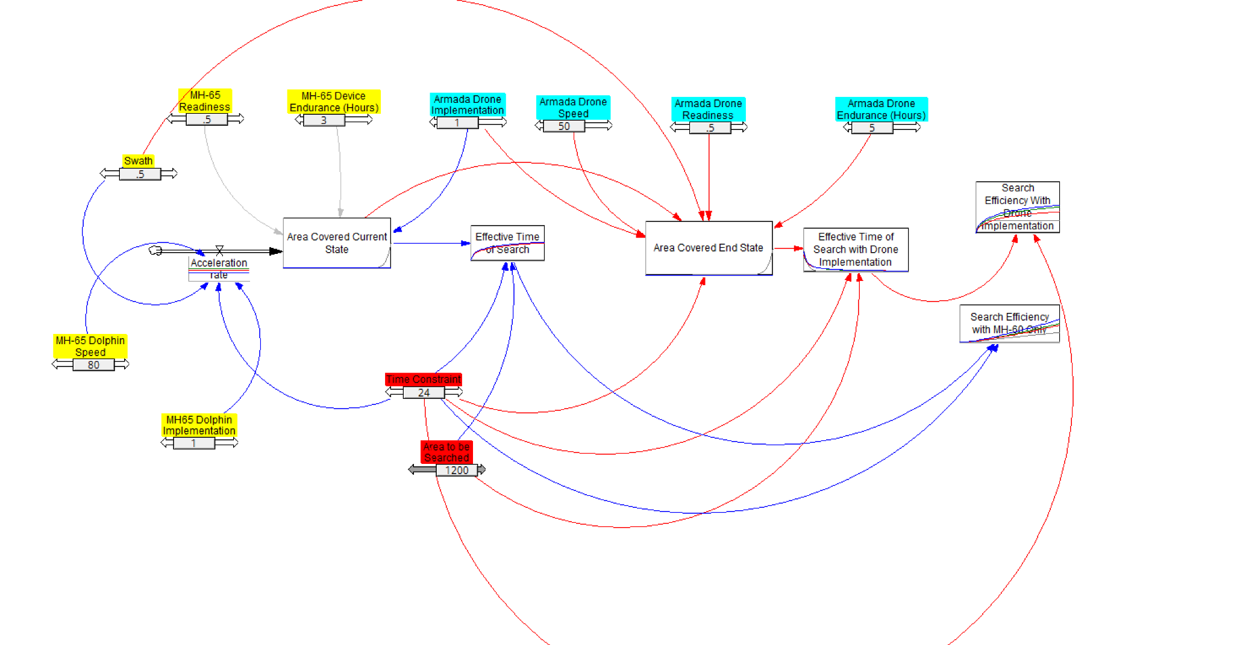
Simulation Model
Notes:
Gloria Rorie

Slide 16
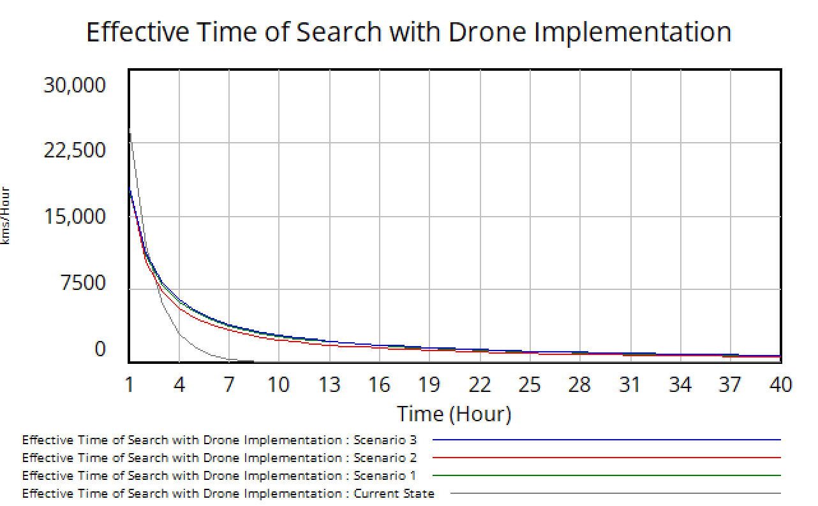
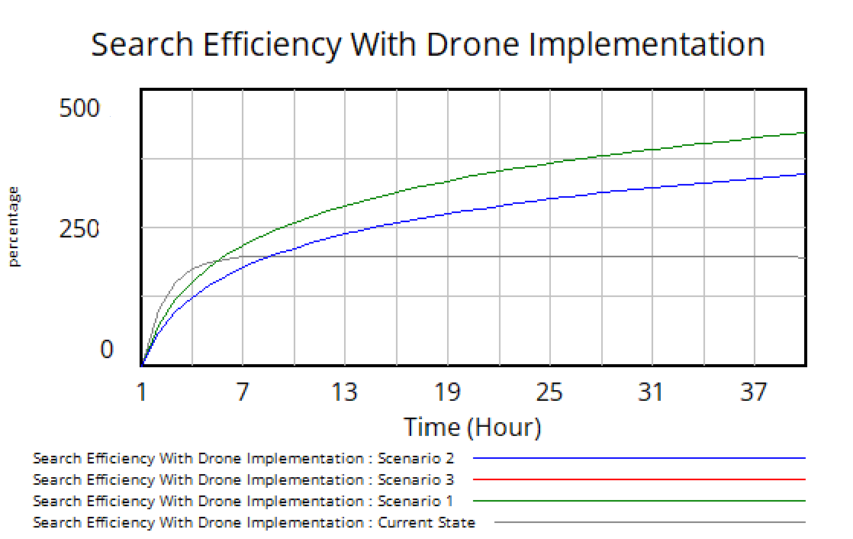
Simulation Model - Results
The Effective Time of Search decreases over time with the implementation of the Armada drones. The Search Efficiency reflects an increased net change of 10% in Scenario 1 and 16% in Scenario 2 compared to the Current State.
Notes:
Gloria Rorie

Slide 17
Risk Management
#1 Supply Chain Disruption Risk
Risk Level 4 (Low)
IF Armada isn’t able to product enough drones for the USCG Search & Rescue Operations
BY the agreed-upon timeline
DUE TO limited resources or supply chain disruptions
THEN it may result in operational delays for the USCG
Likelihood
IMPACTS: USCG fleet availability, delay in production schedule, Armada loss in profits
Mitigation Strategy: Contingency Planning
Invest in expanding manufacturing capabilities to meet the demand
Increasing production lines, hiring additional skilled personnel, or outsourcing
#2
#1
Consequence
#2 Limited Range of Communication Risk
Limited Range of Communication Risk
Risk Level 8 (Medium)
IF the Armada drone is limited in search range
BY delivery to the USCG
DUE TO the limited range of its current cellular communication system
THEN there will be a max search range of 180 km
IF the Armada drone is limited in search range
BY delivery to the USCG
DUE TO the limited range of its current cellular communication system
THEN there will be a max search range of 180 km
Likelihood x Consequence =
Risk Level
1-4: Acceptable
5-9: Adequate
10-16: Tolerable
17-25: Unacceptable
IMPACTS: Limited search capability in SAR operations
IMPACTS: Limited search capability in SAR operations
Mitigation Strategy: Redundant Communication System
Satellite (Starlink) or RF signals
Notes:
Joanne Ro

Slide 18
Risk Management
#3 Cyber Security Risk
Risk Level 10 (High)
IF the Armada drone lacks an implemented cyber security protocol
BY delivery to the USCG
DUE TO an oversight in encryption or secure communication protocols in the design application
THEN the system may be vulnerable to cyber attacks by adversaries
IMPACTS: Complete loss of the SAR operation due to a failure of the drone system
Likelihood
#4
Mitigation Strategy: Cyber Security Considerations
Input cyber security protocols
Ensure regular software updates
Use secure communication channels
#3
Consequence
#4 Maritime Environment Drone Exposure Risk
Risk Level 12 (High)
IF the Armada drone is limited in search range
BY delivery to the USCG
DUE TO the limited range of its current cellular communication system
THEN there will be a max search range of 180 km
IF the harsh coastal environment conditions are not considered in drone operations
BY delivery to the USCG
DUE TO the drones not being originally designed for maritime environments
THEN the drone can experience damage to its system due to corrosion
Likelihood x Consequence =
Risk Level
1-4: Acceptable
5-9: Adequate
10-16: Tolerable
17-25: Unacceptable
IMPACTS: Limited search capability in SAR operations
IMPACTS: Accelerate corrosion on the drone, shortening its lifetime use period
Mitigation Strategy: Design & Maintenance Considerations
Protective coatings, corrosion-resistant materials
Regular maintenance
Notes:
Joanne Ro

Slide 19
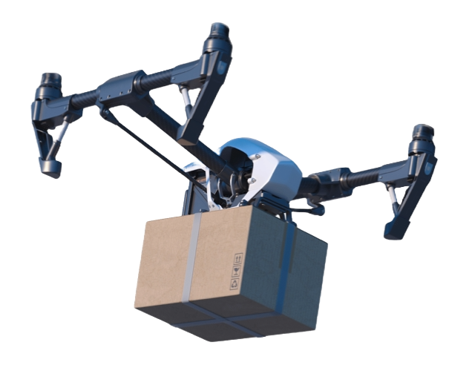
Conclusion
Key Question: Could the integration of Armada's gas-powered, long-range, drone into SAR operations contribute to a 10% enhancement in search effectiveness?
Endurance
Swath
Speed
Readiness Time
Area Covered
Effective Time of Search
Search Effectiveness
INPUT
OUTPUT
Answer: Yes!
Increase search area coverage
Reduce search time
Improve Search Effectiveness 10-39% based on our analytical simulation model
Promising perspective for Armada to expand their drone business by entering the SAR venture in the United States with their gas-powered long-range drone design
USCG enhancement of SAR missions using drones, potentially leading to more lives saved in emergency situations
Further exploration & innovation in SAR technology and the growing application of drones
Notes:
Joanne Ro

Slide 20
Lessons Learned & Recommendations
Lessons Learned
Clear & Defined Objectives
Switch from broad objective of Lives Saved to more focused approach of Search Effectiveness
Adaptability
Quickly adjust objectives & approach when faced with data limitations & project expectations
Risk Management
Identifying potential risks & development of mitigation strategies
Complexity in Interoperability
Complexity of introducing new technology into an established operation requires adaptability and robust risk management
Recommendations
Communication
Integration of a redundant communication systems to expand the drone’s current communication range of 180 km
Cyber Security Measures
Implement cyber security protocols to protect sensitive information and the drone system
Consideration of Environmental Impacts
Assess and implement corrosion-resistance measures that can withstand coastal environments
Notes:
Joanne Ro

Slide 21
References
[1] HH/MH 65 dolphin - US coast guard / USCG aircraft - A-T products. (n.d.). US Military Art. Retrieved October 12, 2023, from https://www.usmilitaryart.com/USCG+Aircraft-69/HHMH+65+Dolphin-807
[2] Murray, K. (2021, November 15). Coast Guard drones can see underwater and inside vessels during response to hurricanes and extreme weather events. United States Coast Guard. Retrieved September 30, 2023, from https://www.mycg.uscg.mil/News/Article/2841972/coast-guard-drones-can-see-underwater-and-inside-vessels-during-response-to-hur/
[3] Office of Program Analysis and Evaluation (CG-PAE). (2023, January 26). U.S. Coast Guard: FY2022 performance report. ArcGIS StoryMaps. Retrieved September 29, 2023, from https://storymaps.arcgis.com/stories/2834ff7be6874a94accf430b1c11a178
[4] Tegler, E. (n.d.). Maritime 9-1-1 | Defense Media Network. Defense Media Network. Retrieved October 10, 2023 from https://www.defensemedianetwork.com/stories/maritime-9-1-1/
[5] United States Coast Guard (USCG), U.S. Coast Guard Addendum to the National Search and Rescue Supplement (NSS) to the International Aeronautical and Maritime Search and Rescue Manual (IAMSAR), Appendix H. Accessed 7 Sep 2023.
[6] United States Coast Guard, n.d. MH-65 Short Range Recovery Helicopter. Retrieved 18 Sep 2023 from https://www.dcms.uscg.mil/Our-Organization/Assistant-Commandant-for-Acquisitions-CG-9/Programs/Air-Programs/SRR-MH-65
[7] Wikipedia contributors. (2008, November 18). File:CMF SearchPlan on Chart.JPG. Wikipedia. https://en.wikipedia.org/wiki/File:CMF_SearchPlan_on_Chart.JPG

Slide 22
Q&A

