Slide 1
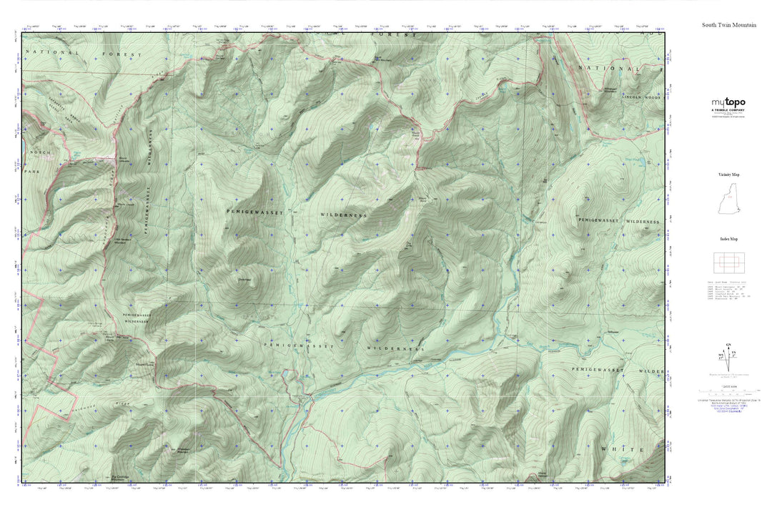
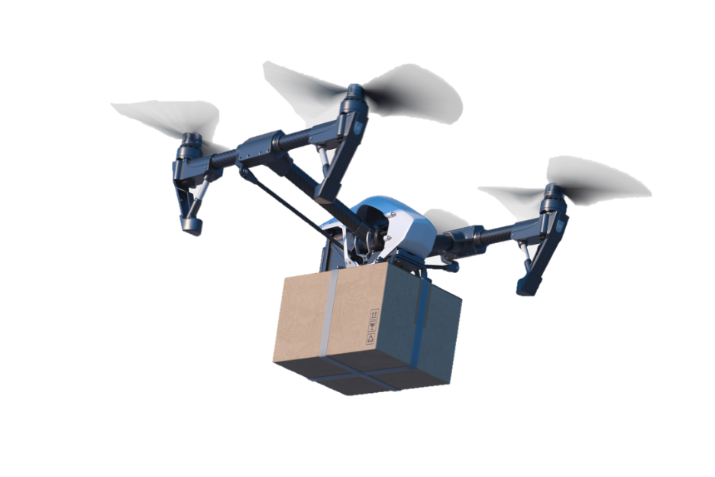
ENM 607: Capstone C
Using Drones to Reduce GHG Emissions for Deliveries to Remote Locations
Presented by
"The Fellowship of the Five"
Omar Acuna
Ben Nicholas
John Sievert
Patrick Tonganbou
Steve Wolford
Instructor
Professor Derek Podobas
10 /14 / 2023
Notes:
Ben:
Good Evening, and welcome to our final Capstone presentation.
Thank you all for being here, it means a lot to us.
We are Team 2, also known as "the Fellowship of the Five,"
And we are excited to present our feasibility study for an Environmentally friendly long-range delivery drone.

Slide 2
Complete Isolation
Canada: 182 Remote Communities
Alaska: 240 Remote Communities
Types of Communities:
Native Villages
Mining Operations
Canneries
Research Facilities
"Towns"
2
Notes:
Ben:
Between Canada and Alaska, there are 422 communities so remote, their only means of access are by aircraft. Many of these aircraft are old, inefficient, and release hundreds of thousands of pounds of CO2 into the atmosphere with every trip; especially when their only cargo is a bottle of medication, a single repair part, or a few parcels of mail; something a drone could easily deliver with a minute fraction of the GHG emissions.

Slide 3
Focus of Presentation
Key Question:
Is developing and implementing a long-range delivery drone system feasible and capable of genuinely impacting greenhouse gas emissions significantly compared to traditional methods?
Project Purpose:
* Determine feasibility of Armada Drone system reducing
GHG by 70%
* Final Capstone requirements
Project Sponsor:
* Armada Defense Corp. Markham, Ontario, Canada
Project Overview:
* Potential for GHG reductions of 70%
* Environmental Impact of long-range delivery drones
Notes:
Steve:
This presentation will take a deep dive into answering one key question for these communities Ben just mentioned:
Is the development and implementation of a long-range delivery drone system feasible and capable of truly having a significant impact on greenhouse gas emissions compared to traditional methods?
Our specific target threshold for this study was a reduction by 70%.
This project is proudly sponsored by Armada Defence Corp., based in Ontario, Canada. Armada is a unique research and development company specializing in cutting-edge military technologies, particularly in the realm of unmanned aerial vehicles (UAVs).
Our primary goal in this study is to accurately assess the feasibility of reducing greenhouse gas (GHG) emissions through the implementation of long-range delivery drones.
We have examined the objectives of our project with a focus on ethical decision making and feel confident that this project meets all ethical criteria.

Slide 4
The Team members
Omar Acuna
Experienced quality manager with 25 years in electronic manufacturing,
Ben Nicholas
Active-duty USMC for the past 11 years. Bachelor's degree in ocean engineering.
John Sievert
Retired 20 years of US Navy services, worked for 4 years as a mechanical design engineer for Space Sciences Corporation.
Patrick Tonganbou
Manufacturing engineer with two years working within the semiconductor sector
Steve Wolford
Quality Administrator and Engineering Manager with 35 years of manufacturing industry experience.
Formerly a rotary wing powerplant mechanic in the USMC
Holding engineering degrees in industrial and manufacturing design.
Home is a remote community in south central Alaska with 31 permanent residents.
Five years in the aerospace industry.
Notes:
Steve:
Let's take a moment to briefly introduce our team...
We are Team 2 …
Omar is a Quality Manager
Ben is active-duty US Marine Corps
John is currently a Mechanical Design Engineer / Retired US Navy
Patrick is a Manufacturing engineer
Steve is a Quality Administrator and Engineering Manager
And we are team two… the fellowship of the five.

Slide 5
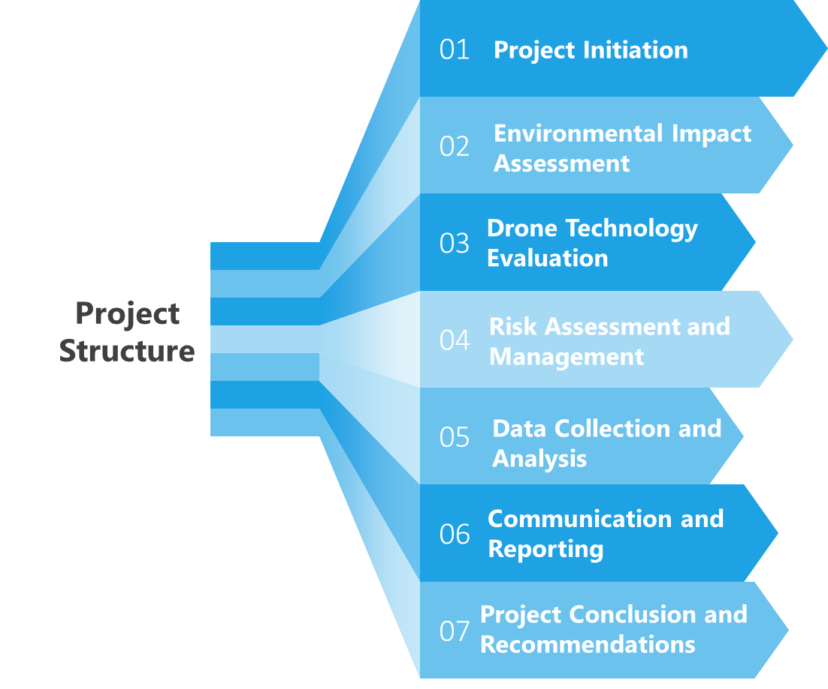
Project Decomposition
Notes:
Steve:
Project Decomposition:
As we break down our project systematically here...
The project initiation… we set out to define our scope and objectives
The Environmental Impact segment… we quantified current GHG emissions tied to traditional delivery methods as well as the Armada drone system.
In the Technology Evaluation phase, we analyze all of the technical aspects and independent variables of Armada's drone.
In our Risk Assessment section… we set out to identify and mitigate all risks related to technology and stakeholder engagement.
We collected GHG emissions data for analysis and quantified any potential reductions.
and then… In the communication and reporting component, we prepared this presentation and a report to communicate our findings…
and will conclude our project with recommendations that summarize the key findings regarding GHG reduction feasibility.

Slide 6
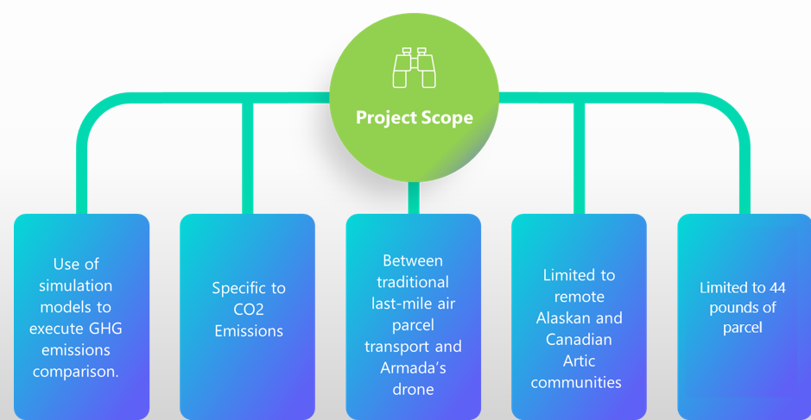
Scope of Work
Notes:
Patrick:
The scope of work
We will use advanced simulation models to conduct a comprehensive greenhouse gas emissions (GHG) comparison, specifically focusing on CO2 emissions.
Our analysis will specifically target last-mile air parcel transport, comparing traditional methods to the innovative Armada drone solution.
This study will be confined to a specific and critical region, focusing on remote Alaskan and Canadian Arctic communities,
where parcel delivery services for packages weighing up to 44 pounds are in high demand.
By concentrating on this region and utilizing simulation models,
we aim to provide a precise and impactful assessment of the environmental benefits that Armada's drone solution can offer in terms of GHG reduction.

Slide 7
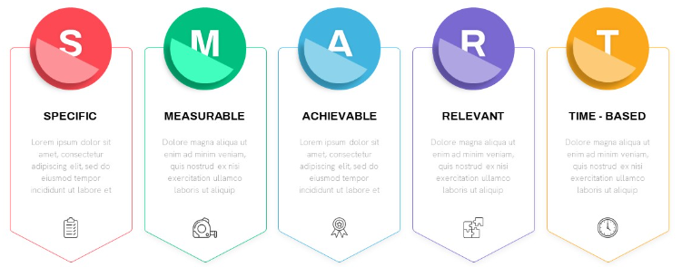
SMART Objectives
Specific
Measurable
Measurable
Attainable
Relevant
Time-Bound
GHG reduction measured by comparing current to future emissions
Timely delivery of report to sponsor
Evaluate Armada vs. traditional transport for remote community delivery impact.
Quantify 70-80% GHG reduction with Armada vs. traditional methods.
Analyze data, affirm Armada's suitability for eco-friendly remote deliveries.
Align with GHG reduction, sustainable short-distance delivery solutions.
T
R
S
M
A
Notes:
Patrick:
Specific: Our objective was to in depth evaluate and compare the environmental impact of Armada's Long-Range solution to traditional transportation methods for delivering to remote Canadian communities within a 250 km range.
Measurable: We successfully quantified a significant reduction in greenhouse gas (GHG) emissions achieved with Armada's Long-Range solution, surpassing our target of a 70-80% reduction compared to traditional transportation.
Achievable: We executed a comprehensive analysis, utilizing environmental data, emissions modeling, and comparative assessments, confirming the feasibility and practicality of implementing Armada's Long-Range solution.
Relevant: Our objectives remained highly relevant throughout the project,
aligning with the urgent global need to reduce GHG emissions and contribute to sustainable, eco-friendly transportation solutions for short-distance deliveries.
Time-bound: We have successfully completed the feasibility study and are here today to present our detailed findings and recommendations, well within the timeframe of this project.

Slide 8
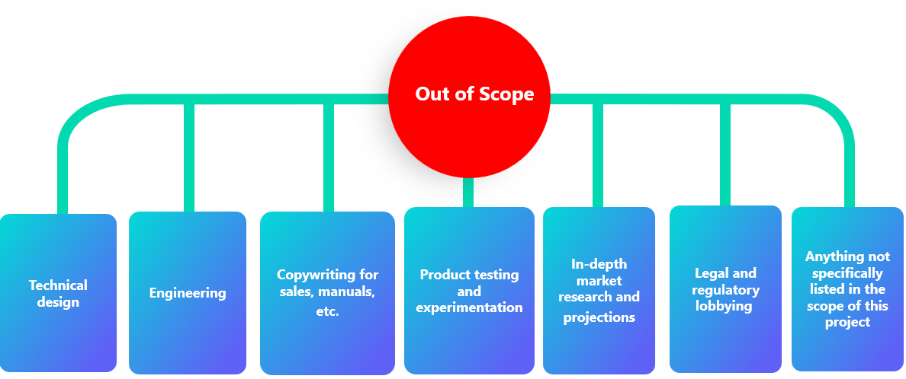
Out of Scope
Notes:
Patrick:
All other work will be out of scope and this has been agreed with our sponsor
It is important to clarify that any work or tasks not explicitly outlined in the defined scope,
such as data collection beyond CO2 emissions or assessments of non-remote communities, will be considered out of scope for this project.

Slide 9
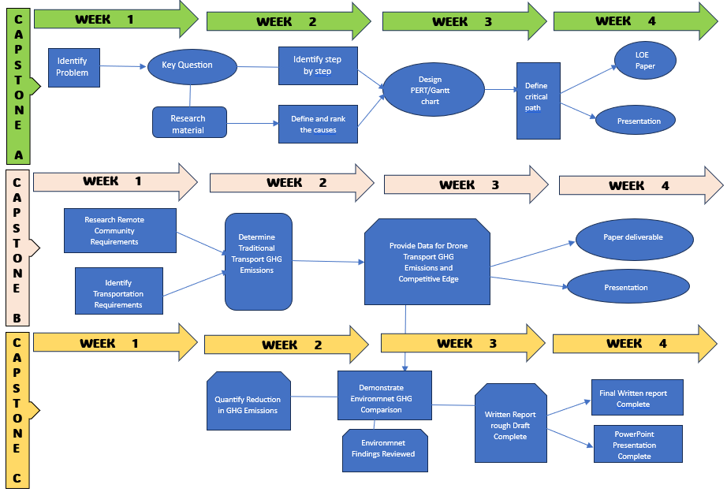
Methodology Flow Chart
Notes:
Patrick:
In our project evaluating Armada's Long-Range Solution for remote deliveries, we've established a structured methodology to maintain clarity and organization throughout.
Capstone A was important for laying the foundation.
Capstone B was dedicated to data collection and analysis.
In Capstone C, we have synthesized our findings into a comprehensive research paper and prepared this final presentation.
This systematic approach has maintained the project's well-structured nature and allowed us to deliver valuable insights.

Slide 10
Morphology Concepts
1Lb. Gasoline = 3.66 Lbs. of CO2
C8H18 + 12.5 O2 →
8 CO2 + 9 H2O
Specific Density of Gasoline = 6.25Lbs. /Gal
Balanced Chemical Equation
Stoichiometric Ratio
Molar Mass of Gasoline C8H18 = .252 lb./mol
Notes:
Steve:
The first objective function we need to come to terms with is the amount of Co2 produced by burning 1 pound of gasoline.
A quick Internet search will show the burning of 1 pound of gasoline produces 3.66 pounds of CO2.
You might wonder how it's possible for one pound of fuel to produce more than three times its weight in CO2 just by burning it… well I'm glad you asked.
The most basic answer would not be a boring chemistry lesson… but the balanced equation you see here that requires 3.53 pounds of oxygen in order to burn one pound of hydrocarbon fuel.
In chemistry this is called a stoichiometric ratio… in case you're taking notes.
In short… the energy released during the combustion process is not a result of converting mass into energy… but rather it's a result of chemical reactions taking place between the air and fuel.

Slide 11
Technology Calculations
Calculating Moles of C8H18 in 1 Gal. = 24.8 Mol
In Stoichiometric Ratio =
8 Moles CO2 are produced
Simulation Models CO2 Emissions per Mile of Flight
Theoretical Combustion Reaction
1 Gal. C8H18 Hydrocarbon Fuel produces
19.26 Lbs. CO2
C8H18 + 12.5 O2 → 8 CO2 + 9 H2O
International Civil Aviation Organization (ICAO) methodology
Distance-based approach = Range / Fuel capacity
Notes:
Steve:
The primary focus of this study on carbon dioxide (CO2) when calculating greenhouse gas emissions is simply because CO2 is one of the most abundant and significant of targeted greenhouse gases.
To calculate the amount of carbon dioxide (CO2) produced from burning 1 gallon of fuel, we utilized the stoichiometric ratio for this theoretical combustion reaction to occur.
The resulting mass of CO2 produced = Moles of CO2 produced times the Molar mass of CO2
According to these calculations 1 gallon of fuel will produce approximately 19.26 pounds of CO2.
Bottom line… The methodology we utilized to calculate fuel efficiency is similar to the methods utilized by the International Civil Aviation Organization… The ICAO is the agency of the United Nations responsible for establishing and reviewing international technical standards for aircraft operations.
The function in this project is a straightforward methodology utilizing a distance-based approach.

Slide 12
Cause and Effect Diagram
ARMADA Drone
Fuel Efficiency
155 Mi
24-hour delivery
44 Lbs. max Capacity
Last-mile air parcel CO2 Emissions
Small Aircraft
400 Mi or more
Fuel efficiency
Helicopter
At least 7 days to deliver
Traditional Air Transport
1000 Lbs.
Notes:
Omar:
The cause- and- effect diagram offers a valuable tool for analyzing the key factors that influence the amount of CO2 emissions generated by parcel deliveries.
When comparing the capabilities of the Armada Drone to traditional air parcel transport, there are subtle distinctions
in three main areas: range, payload capacity, and the time taken for delivery.
These variables were used to determine the Assumptions and limitations of our simulation models

Slide 13
Armada’s Drone implementation Risk Assessment
Low Risk
Moderate Risk
High Risk
Critical Risk
Aviation Regulatory Challenges
LIKELIHOOD
Future Environmental
Concerns
Supply Chain Disruptions
IMPACT

Slide 14
Simulation Model Assumptions and limitations
Models assume linear flight characteristics and does not account for:
Take-off and landing
Headwind or tailwind
Temperature and weather affects
True weight of cargo
Aircraft age, maintenance, and efficiency degradation over time.
Linear Programming Model categories broken into three categories: fixed wing, rotary wing, and the Armada drone.
Notes:
John: The assumptions and limitations that are not in scope include characteristics of linear flight and status of the aircraft. Our team continued to narrow the scope to where we till we were left with three categories we could work and have known variable with in our model to work with these included (Fixed wing, rotary wing, and the armada drone).

Slide 15
Transportation Network
Type of Transport
Xij= Number of CO2 Lbs. emissions
Miles to destination
A
(50 )
Demand 44 Lbs.
Supply
1000 lbs. of parcel
300
1
(Fix wing)
600
350
B
(100)
900
2
(Rotary)
700
C
(150)
2
1050
1200
4
1400
6
D
(200)
3
(Drone)
1750
1500
8
10
E
(250)
Notes:
Omar
Within this model, our decision variables correspond to the CO2 emissions per mile generated by the three primary aircraft types: small planes, helicopters, and the Armada drone.
Our objective function is geared towards minimizing carbon dioxide (CO2) emissions in the context of the last-mile parcel transportation process.
This objective is mathematically represented in the equation seen in the right side of the slide.
The model is further characterized by specific demand constraints, necessitating a minimum collection of 1000 pounds of parcels before deploying delivery transport to these remote communities.
Additionally, the supply of parcels for each delivery is constrained to a maximum of 44 pounds.
This modeling approach allows us to quantitatively assess the environmental impact and determine if the Armada drone can indeed reduce CO2 emissions by the targeted threshold of at least 70%.

Slide 16
Linear Programing model
Objective Function Value (OFV)
Decision Variables
Xij= Number of CO2 Lbs. emissions
Minimize
Y= 300X1A+600X1B+900X1C+1200X1D+1500X1E+350X2A+700X2B+1050X2C+1400X2D+1750X2E+2X3A+4X3B+6X3C+8X3D+10X3E
Subject to:
X1A+X1B+X1C+X1D+X1E ≤ 1000 lbs. X2A+X2B+X2C+X2D+X2E ≤ 1000 lbs.
X3A+X3B+X3C+X3D+X3E ≤ 1000 lbs.
Subject to:
X1A+X2A+X3A ≤ 44 lbs.
X1B+X2B+X3B ≤ 44 lbs.
X1C+X2C+X3C ≤ 44 lbs.
X1D+X2D+X3D ≤ 44 lbs.
X1E+X2E+X3E ≤ 44 lbs.
Notes:
Omar
Within this model, our decision variables correspond to the CO2 emissions per mile generated by the three primary aircraft types: small planes, helicopters, and the Armada drone.
Our objective function is geared towards minimizing carbon dioxide (CO2) emissions in the context of the last-mile parcel transportation process.
This objective is mathematically represented in the equation seen in the right side of the slide.
The model is further characterized by specific demand constraints, necessitating a minimum collection of 1000 pounds of parcels before deploying delivery transport to these remote communities.
Additionally, the supply of parcels for each delivery is constrained to a maximum of 44 pounds.
This modeling approach allows us to quantitatively assess the environmental impact and determine if the Armada drone can indeed reduce CO2 emissions by the targeted threshold of at least 70%.

Slide 17
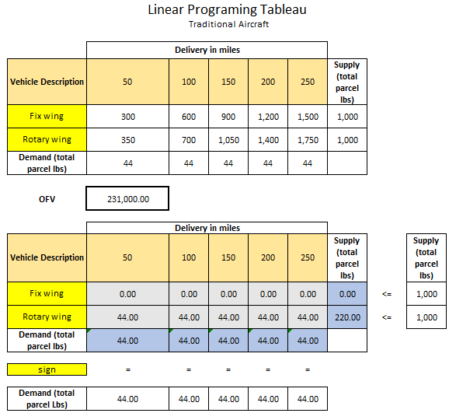
Linear Programing Tableau
Minimize CO2 emissions conventional aircrafts comparison
Notes:
Omar:
Given this, we constructed two different tables to serve as the basis of comparison between
Armada Drone and conventional air delivery.
In which excel Solver was used to provide the solution

Slide 18
Causal Model for CO2 Emission Reduction
Payload
Number of Deliveries
Air Transport Type & Fuel efficiency
Pound of CO2 per Mile
Range
Notes:
Omar:
To address some of the limitations or our original lineal programing model
The following casual diagram was drafted allowing us to assess the effects of range, payload, and number of deliveries and the inherent CO2 emissions.
The observations made in this model provided valuable insights
To develop a simulation model that helped us to systematically explore the connections between these factors.
Gaining a deeper understanding of how each contributes to CO2 emissions.
For instance, a greater payload capacity may necessitate larger, less fuel-efficient aircraft, potentially increasing emissions.
Conversely, a longer range might enable more efficient routing, reducing emissions.
The period between delivery could influence the frequency of flights, which, in turn, impacts emissions.

Slide 19
CO2 Emission Reduction Simulation Tables
Notes:
Ben:
The first two linear programming models we created were useful, but we wanted to try a different approach using a simulation model. The result was this heat table.
This simulation table was generated using a slide bar tool in excel. The units of the values in the heat table are pounds of CO2 emitted per mile, while the table on the right shows the percent reduction in CO2 emissions for each aircraft compared to the Armada drone.
***[Excel Demonstration]***

Slide 20
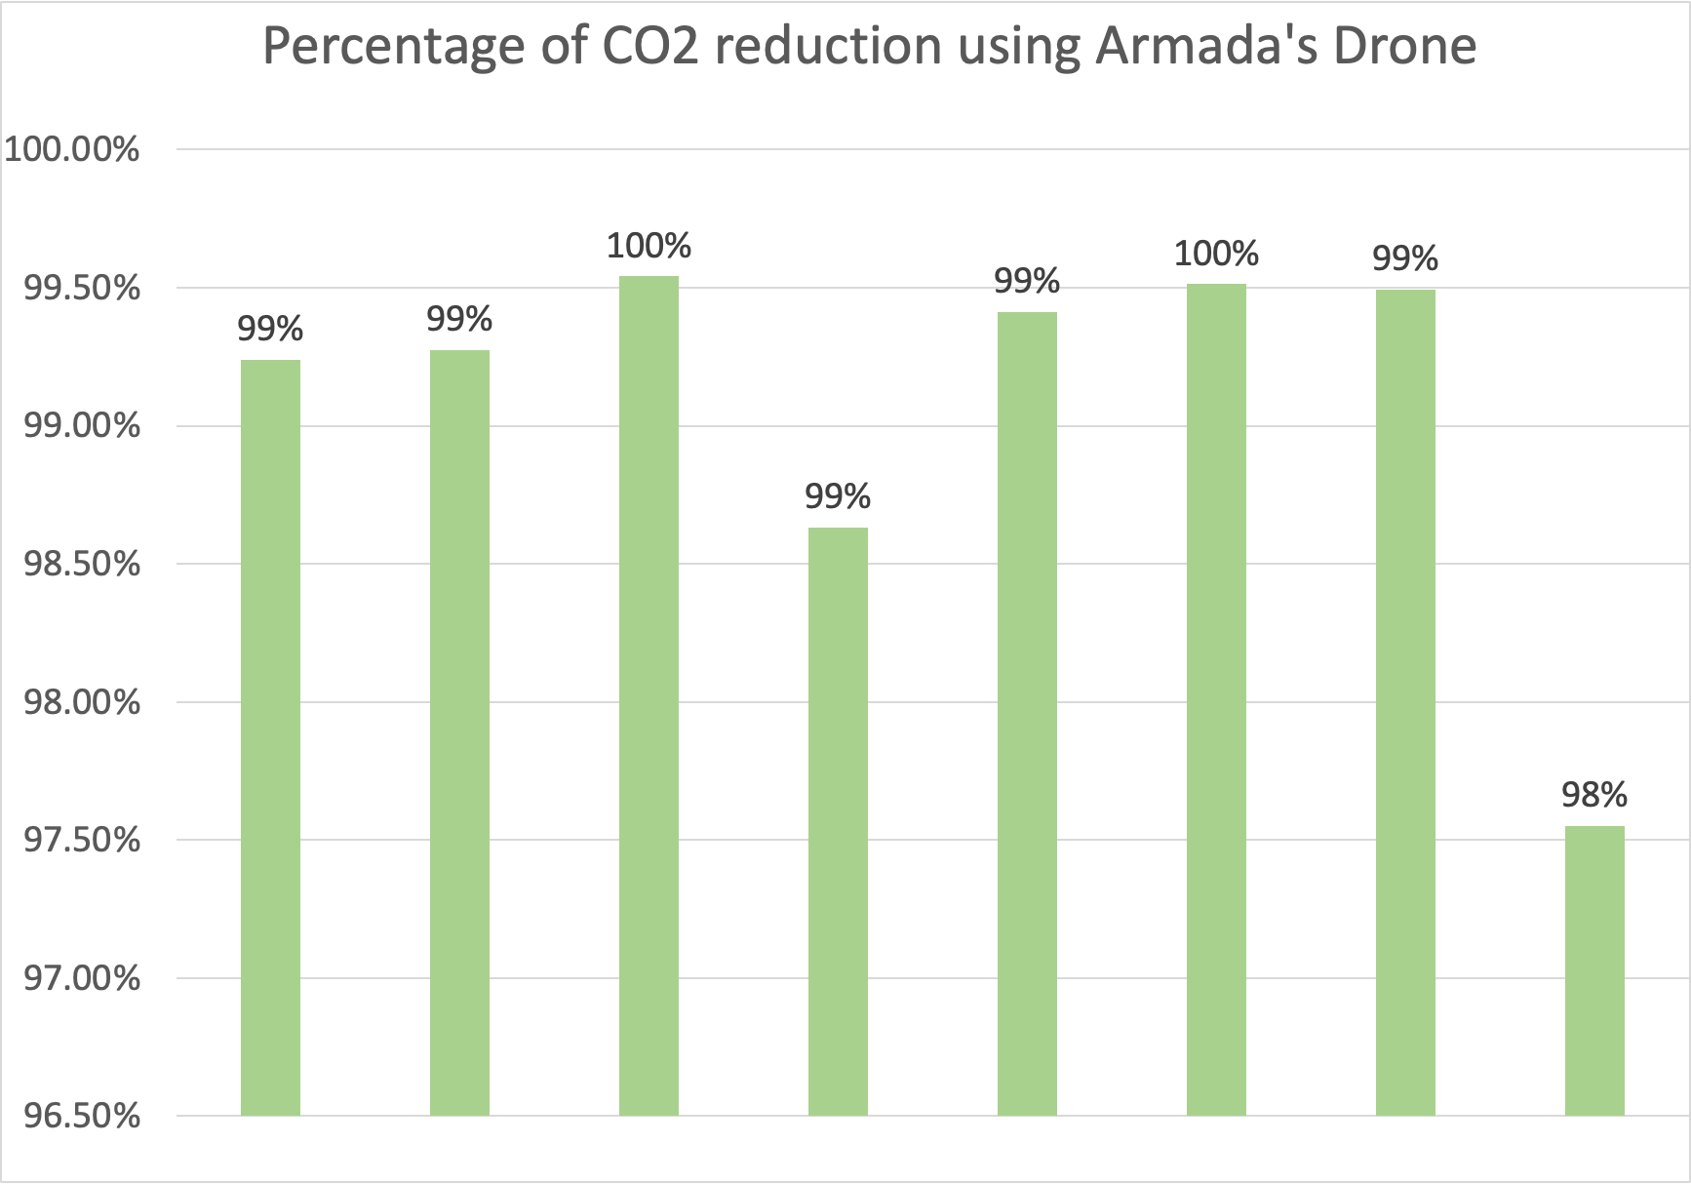
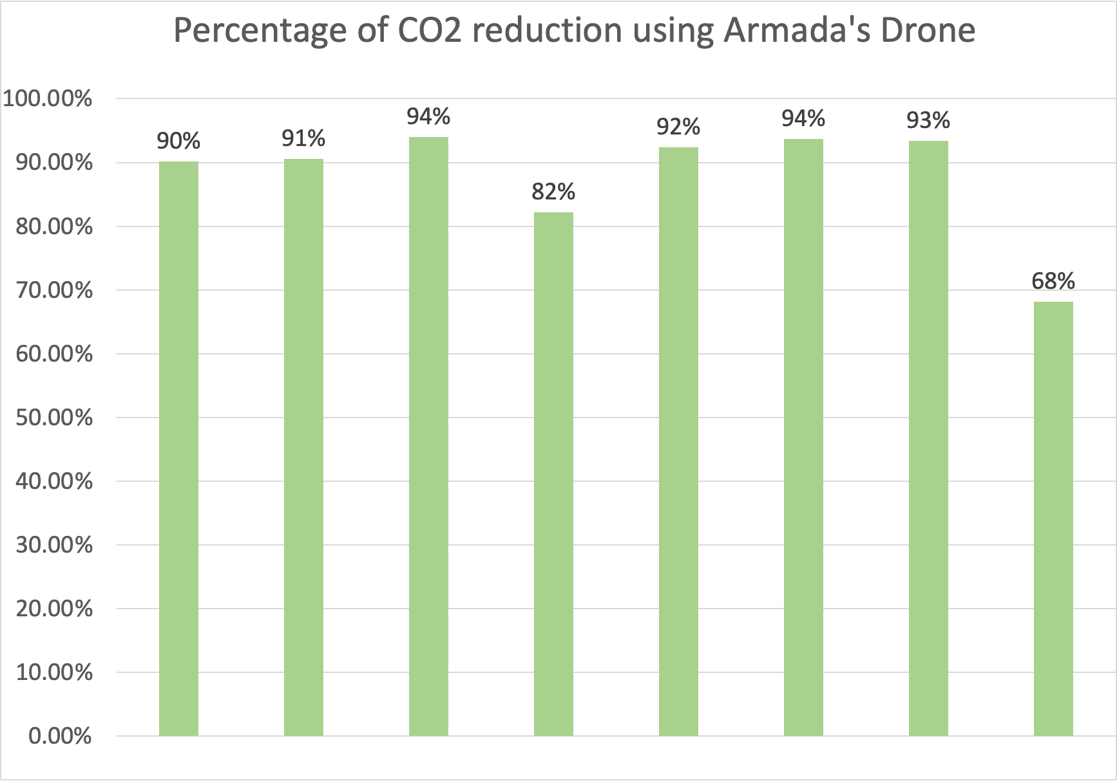
CO2 Emission Reduction Simulation Tables
Package Weight: 44 lbs (1 Armada Drone)
Package Weight: 529 lbs (13 Armada Drones)
Beachcraft
Cessna 208
Airbus AS350
Cessna 208
Airbus AS350
MD 500 E
Beachcraft
MD 500 E
DHC-6
Bell 205
DHC-6
Bell 205
PA-31
R44
PA-31
R44
Notes:
Ben:
Here is a graphical depiction of the percent reduction using the Armada drone table compared to each of the traditional aircraft.
The left shows a scenario requiring only one Armada drone, with the lowest result being a 98% reduction in CO2 emissions by weight.
The right shows a scenario requiring 13 armada drones. Although the Armada drone is still more efficient than all other traditional transportation methods, this is the tipping point where the Armada drone reduces CO2 emissions by less than 70% when compared to the Robinson R44 helicopter.

Slide 21
Key Question: Answered
Assumptions
Access 70% of remote communities
Average distance POO to POD is 75 miles
Drone deliveries 6 days/week
Traditional deliveries 1 day/week
Traditional platforms used equally
Drone production = 300 drones/year
Drone delivery infrastructure in place
Desired Percent CO2 Reduction
70%
80%
Notes:
Ben:
Realistically, the Armada drone cannot replace all traditional air transport methods, so we asked ourselves, "what does a scenario look like where the Armada drone is used in conjunction with traditional air transport methods to reduce GHG emissions by 70%-80%"?
First, a few more assumptions had to be made: (see slide)
Then, using data calculated from the balanced chemical equation and our heat map simulation table, we were able to determine a more feasible solution:

Slide 22
Key Question: Answered
37 Deliveries/Week
10 Deliveries/Week + 162 Drone deliveries/Week
CO2 Emissions: 1,949,453 lbs./wk.
01
01
CO2 Emissions: 584,836 lbs./wk.​
Current CO2 Emissions​
02
Current State
Future State
02
70% Reduction in CO2 Emissions​
Communities receive 1 delivery per week
Communities receive up to 6 deliveries per week
03
03
Greater total payload capacity​
04
Drone production = 300 drones/year
04
216 drones required to service all accessible communities
Notes:
Ben:
For each traditional aircraft platform, reduce traditional transportation methods from 37 round trips/week to 10 round trips/week and use the Armada drone to fill the delta. This method allows heavier and bulkier items to still be delivered by traditional aircraft, while the majority of "normal parcels" can be delivered much faster at a fraction of the environmental cost.
****
27 deliveries x 6 days/week = 162 drone deliveries/week
27 deliveries per aircraft X 8 types of aircraft analyzed = 216 drones required to service all accessible communities

Slide 23
Gap analysis
Notes:
John:
Current Situation: Our analysis reveals that the last mile air parcel delivery process generates approximately 19.6 pounds of CO2 emissions.
(A) This assessment is based on preliminary assumptions, laying the foundation for future environmental impact studies.
(B) These assumptions, although valuable, lack precision due to the absence of real-time field research.
(C) To bridge the gap between the current situation and our goal, it is imperative to replace assumptions with concrete field research.
D) Additionally, crucial variables such as weather, flight patterns, and operational carbon footprint have not been factored into the feasibility study.
(E) Furthermore, integrating 4D modeling into our future studies will enhance the depth of our analysis.
(F) In our ideal scenario, we aim to validate the claim that air drones can potentially reduce CO2 emissions by up to 70%.
Ideal Situation: Validating our findings through sample drone runs will solidify the credibility of our conclusions, leading us closer to a sustainable and efficient last-mile delivery system.

Slide 24
Risk Analysis and Mitigation Options
Environmental Feasibility Study Failure Mode and Effect Analysis (FMEA) |  |  |  |  |  |  |  | Date: 10/9/2023 | Rev. 3
Stage | Failure Mode/ Risk | Sensitivity of Consequence (S) 1 = No Effect-10 = Severe | Likelihood of Occurrence (L) 1 = Remote-10 = Certain | Ability to Detect (D) 1 = Easy -10 = Difficult | Risk Priority Number (RPN): RPN = S x L x D | Expected Date of Risk Realization | Expected Impact to the Project's: Time, Cost, Performance, and Quality | Mitigation Plan | Status (Open or Closed)
Operations and deployment of drone | Armada's drone production capacity is insufficient to deploy drones | 10 | 3 | 1 | 30 | After Project Delivery | The insufficient number of drones being deploy will affect the reduction of CO2 | TBD by Armada | Open
Operations and deployment of drone | Gaps found between feasibility study and drone operation output data | 7 | 7 | 2 | 98 | After Project Delivery | Quality of Theorical assessment is compromised | Environmental study needs to be recalibrated using new data outputs from drone operation. New set of variables and restrictions could be considered | Open
Operations and deployment of drone | Drone not as efficient as calculated after manufacturing | 9 | 6 | 4 | 216 | After Project Delivery | Performance specifications below advertised standard | TBD by Armada. Recommend additional research and calculations for new employment scenarios to reduce GHG emissions by 70% | Open
Notes:
Ben:
This is our team's qualitative risk assessment Matrix and Failure Mode and Effect Analysis. These are the only remaining risks listed as "open," given that we are nearing the end of our CAPSTONE project.
Both of these risks apply to actually implementing Armada's drone into the remote community delivery sector.
[Next Slide]
***
Three Remaining Risks:
-Armada's drone production capacity is insufficient to deploy drones.
-Gaps found between feasibility study and drone operation output data.
-Drone not as efficient as calculated after manufacturing.

Slide 25
Summary and Findings
Key question can CO2 emission by 70-80% compared to traditional methods for communities relying on small aircraft for essential deliveries
Through meticulous research and calculations, we determined that burning 1 gallon of C8H18 hydrocarbon fuel produces approximately 19.26 pounds of CO2.
Armada's drones were significantly more efficient than traditional aircraft, emitting only 0.28 CO2 per mile per pound of cargo compared to 19.73 CO2 per mile per pound for planes.
Our research indicated that Armada's drones were optimal for deliveries up to 44 pounds, emitting substantially lower CO2 compared to traditional aircraft.
However, beyond a certain weight threshold (924-968 lbs), helicopters became a more efficient option.
Notes:
John:
We have met all objectives outlined in the letter of engagement to the satisfaction of our sponsor.
Our team study focused on evaluating the feasibility of implementing Armada's Long-Range drone solution for delivering parcels to remote Canadian communities within a 250 km range. This initiative was crucial due to the 422 communities in Canada and Alaska relying on small aircraft for essential deliveries. Sponsored by Armada Defense Corp., our objective was to assess the potential reduction in greenhouse gas (GHG) emissions, targeting a 70-80% decrease compared to traditional transportation methods.
Our methodology involved a detailed analysis of GHG emissions, utilizing a distance-based approach ratio for hydrocarbon fuel combustion. Through meticulous research and calculations, we determined that burning 1 gallon of C8H18 hydrocarbon fuel produces approximately 19.26 pounds of CO2.
To evaluate the environmental impact, we developed a simulation model incorporating various variables such as delivery weight, aircraft types (small plane, helicopter, and Armada drone), and CO2 emissions per mile. This model allowed us to explore different scenarios, revealing that Armada's drones were significantly more efficient than traditional aircraft, emitting only 0.28 CO2 per mile per pound of cargo compared to 19.73 CO2 per mile per pound for planes.
We established specific constraints, requiring a minimum collection of 1000 pounds of parcels before deploying delivery transport, with each delivery limited to 44 pounds of parcels. Our research indicated that Armada's drones were optimal for deliveries up to 44 pounds, emitting substantially lower CO2 than traditional aircraft. However, helicopters became a more efficient option beyond a certain weight threshold (1,804 lbs) of cargo. Our study demonstrated the viability of Armada's Long-Range drone solution for reducing GHG emissions in last-mile parcel transportation, especially for lightweight deliveries. Our findings underscore the potential of long-range delivery drones in addressing environmental concerns and providing sustainable, eco-friendly transportation solutions for remote communities.

Slide 26
Questions??

Slide 27
References
1. Frawley, G. (1997). The International Directory of Civil Aircraft 1997/98. Australian Aviation.
2. Mcameron. (2021, April 13). Best Vehicles to own for Alaskan Living - Royal Alaskan Movers. Royal Alaskan Movers. https://www.royalalaskanmovers.com/best-vehicles-to-own-in-alaska/
3. MD Helicopters, LLC. (2023, April). MD 500E Helicopter Specifications. MD Helicopters.com. Retrieved September 12, 2023, from https://www.mdhelicopters.com/wp-content/uploads/2023/05/MD-500E_Product-Spec_May-2023.pdf
4. Robinson Helicopter Company. (2020, January). R44 Raven II and Clipper II. robinsonheli.com. Retrieved September 12, 2023, from https://robinsonheli.com/wp-content/uploads/2020/01/raven_2_brochure.pdf
5. Single engine Airbus AS350 B2 (A-Star). (n.d.). Bristow Group Inc. https://www.bristowgroup.com/fleet/single-engine/airbus-as350-b2-a-star
6. Fuel Economy 2023 Trucks: https://www.fueleconomy.gov/feg/PowerSearch.do?action=noform&path=1&year1=2021&year2=2021&make=Ford&baseModel=F150&srchtyp=ymm

Slide 28
Appendix

